Slide 1
Virtual Academy
Gauttam Sonkamble
Vaishali Kalbhor

Slide 2
Introduction
In Virtual Education System connects the people who want to learn and who want to teach.It helps people who cannot go to the school or college to study like girls in backward area and physically disable people.
There are three main user of the system Admin, Faculty, Student Admin will log in the system in the log in menu and the system will direct this user to admin interface.
Faculty can be a user of the system after passing the exam taken by the VES. He will log the system in the log in menu and the system will direct this user to faculty interface.
He can study the as per his convenience. Appear for test, View progress report and participate in extra-curricular activates online.

Slide 3
Scope:
The growing popularity of Internet and e-learning introduced new terms to education, such as “Virtual Education System”.
May be in the near future students will not go to anywhere in order to take their studies.
The concept “Virtual Education System” enables users to learn from anywhere through Internet and provides a learning experience.
This project is intended to give both teacher and student the ability to do their jobs effectively and efficiently without even leaving their places. By this solution we aimed to meet the expectations of both students and faculties.

Slide 4
Modules
Registration:
Login:
Course:
Browse,
Search and View
Navigation Interfaces of Application
Download
Upload
Report

Slide 5
Registration:
Registration module is use to register to Virtual Education System for accessing the information from this system as well as view and download the important contains from the this system.
Add Course:
Add course module is use to create new course as well as add new course. Only Admin can create new course and add new course.
Upload Contains:
In Upload module Admin and Teacher can upload the subject contents and notes course related materials.

Slide 6
Modification:
In modification module Admin and Techer can modify the contents of course and change the contents of course or can change the any topic.
Deletion:
Deletion module is use to delete the course and contents of topic. Here only Admin and Teacher can delete the contents of course and only Admin can delete the course.
Generate Report:
In Report module Admin and Teacher can generate the report and download the report from system.

Slide 7
View:
In this module user can view this site as well as view the study material and access the information from this system.
Browse:
Browse the information from this system in video ,audio, text, and image format.
Download:
User can download the contents from the system as well as can download the video or course from the system.

Slide 8
Advantages
No physical boundary
Multiple Access
Information & Notes Retrieval
Easily Accessible
Time saving

Slide 9
Disadvatages
If Software is damaged then whole data is corrupted.
No cost.

Slide 10
Objectives
The main objective of VES is to provide an online learning experience to the registered student of the portal.
The registered students and faculties can also interact with each other thus providing a healthy and friendly environment to learn while not physically in the lecture hall.
Some of the advantages of the VES are Removal of geographical barriers. (Anywhere learning) Quicker to organize. One to one communication.

Slide 11
Existing System
Traditional method student can take education in particular time and in particular place only.
Traditional methods of teaching within class rooms, lectures and face to face interaction, increases costs within the educational system.
limits academic institutions from offering additional further education courses, creates unavailability of staff for teaching additional courses and limits distant learning.

Slide 12
Proposed System
The limitations with traditional methods is that of students difficulty of asking questions on the course material due to lack of knowledge and understanding, a key problem in both class room and lecture teaching, and many students also don’t participate and fall asleep within lectures.
This is a common problem across many further education academic institutions.
Using a virtual learning environment the experience becomes personal for the uses, and constant interaction and engagement with the user is required.
Students who are embarrassed to ask questions are able to follow virtual course material at a suitable pace, and interactive applications can be developed to provide a further detailed understanding of the material.
Teaching staff are able to address larger group of students to deliver course material delivered more than once.

Slide 13
Software and Hardware Requirements
Technical Details:
Front End : Angular, Bootstrap, HTML,CSS
Back End : Java
Databse : MySQL
Framework : Spring Boot

Slide 14
Software and Hardware Requirements
Software requirement:
Spring Tool Suit(STS)
MySql Workbench
Firefox / chrome (Advanced Browser)
JDK 1.8

Slide 15
Software and Hardware Requirements
Hardware requirement:
Minimum 8 GB RAM
20 GB Hard Disk Space
Monitor
Mouse
Keyboard
Smart Mobile

Slide 16
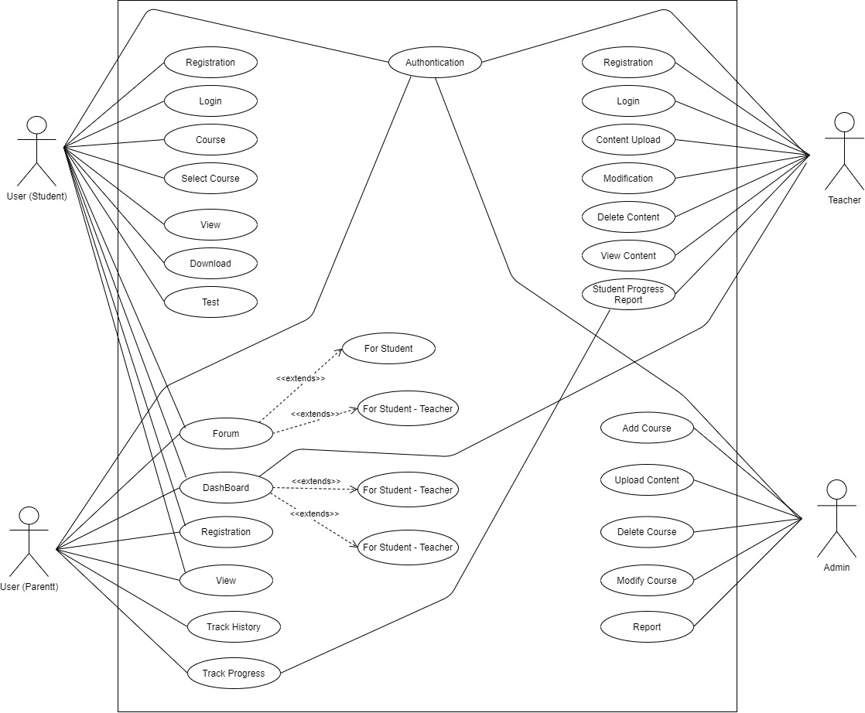
Use Case Diagram
Admin:
System

Slide 17
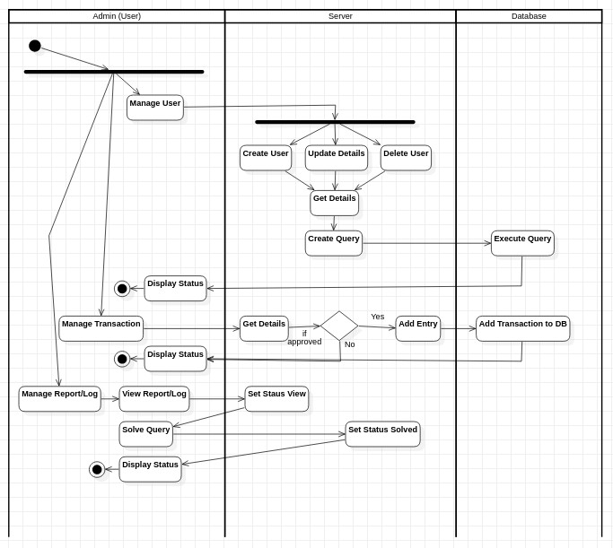
Activity Diagram
Admin:

Slide 18
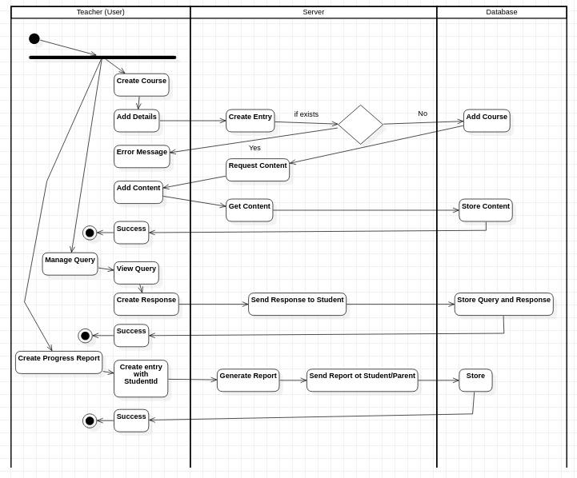
Teacher:

Slide 19
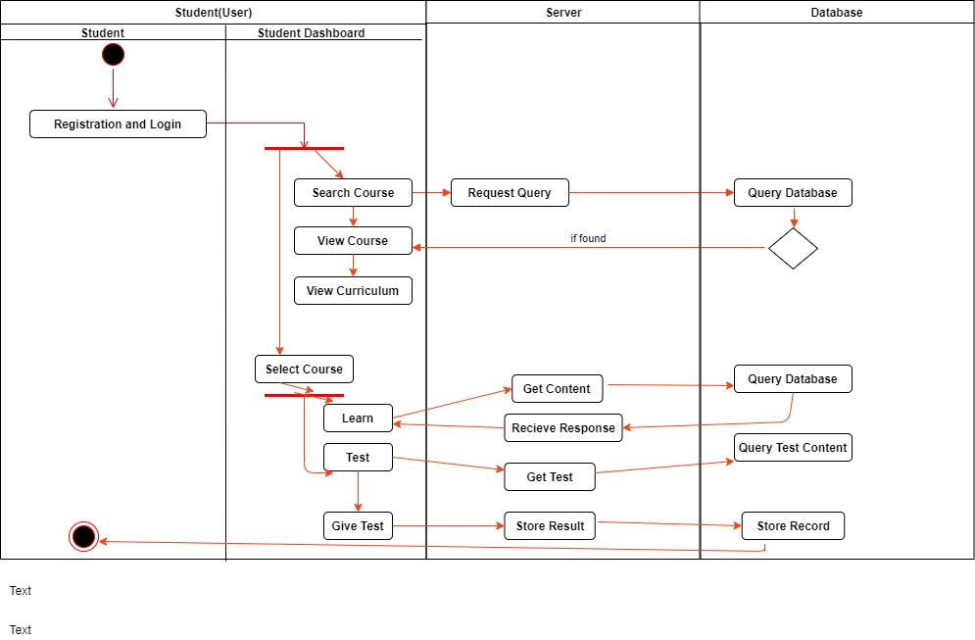
Student:

Slide 20
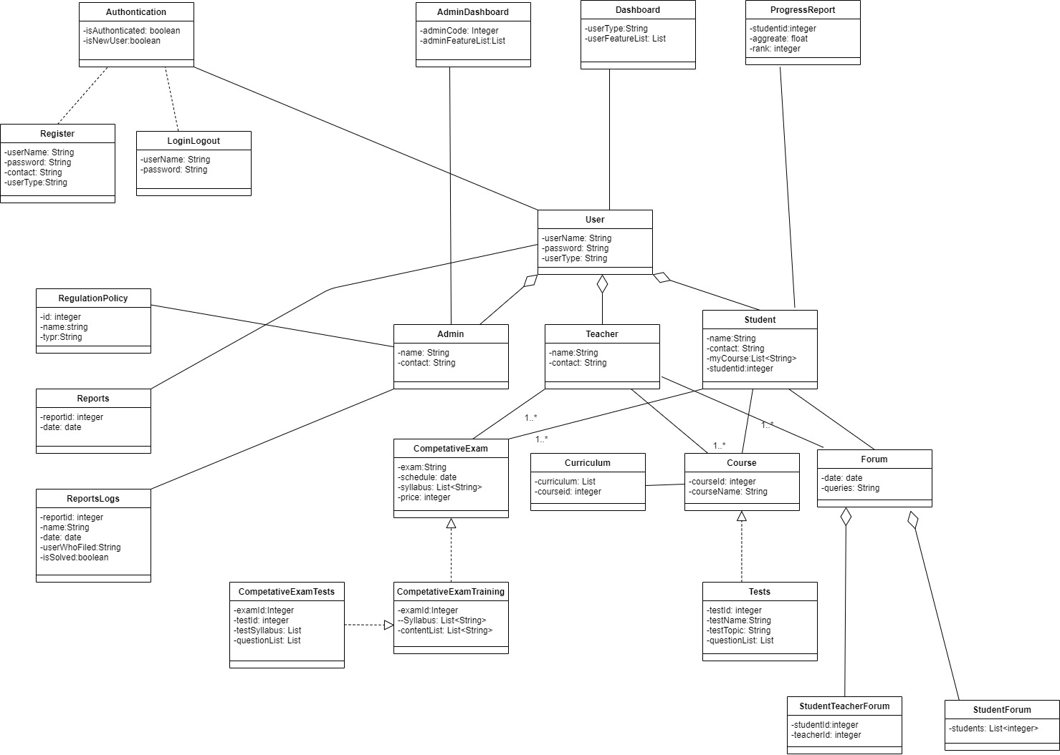
Class Diagram:

Slide 21
THANK You

